Slide 1
Notes:
This slide may be shown at the beginning of the presentation.

Slide 2
Our Role
Delivering S&T for defence and security
Maximising impact and value from the S&T Portfolio
Supplying specialist S&T services which must be done in Government
Providing expert and impartial advice, analysis and assurance
Integrating S&T delivered by industry, academia, wider Government and its allies
Notes:
The role of Dstl is two-fold
1. Delivering S&T for defence and security by,
Maximising impact and value from the S&T Portfolio.
Supplying specialist S&T services which must be done in Government.
Providing expert and impartial advice, analysis and assurance.
Integrating S&T delivered by industry, academia, wider Government and its allies.…

Slide 3
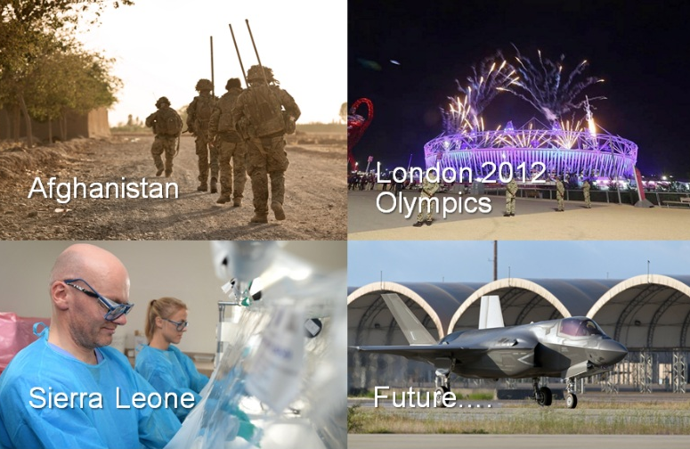
Notes:
This is a context slide and shows some of the recent situations where Dstl has been involved and had an impact.
Dstl helps MOD find solutions for threats by finding counter measures, equipping our troops with battle-winning kit and providing data and information to help make decisions. In 2012 Dstl was involved in the security of the London Olympics and in 2014 the Glasgow 2014 Commonwealth Games, providing support and advice around security and screening etc.
Dstl is also here because there are times when other countries are in need of measured support from the UK MOD.
Case Study
Supporting the effort to tackle Ebola in Sierra Leone
Dstl supported the UK government’s effort to tackle Ebola both at home and abroad. Dstl was initially called upon to provide advice to MOD to help plan protective measures for UK troops being sent to the area. However, the involvement soon escalated and alongside Public Health England (PHE) and other government departments, Dstl worked to contain the virus: the best defence to the UK was to prevent it from reaching our shores.
Teams of expert microbiologists from Dstl also deployed to Sierra Leone to work out of the PHE-run diagnostic field facilities, the deployed scientists were testing blood samples from people suspected of having Ebola.
Furthermore, a novel method of testing blood, has been jointly developed by Dstl and UK industry company BBI. Requiring only a drop of blood, the simple test allows health workers not trained in taking blood from veins to give a swift point-of-care indicative result to confirm Ebola Virus Disease in individuals showing symptoms.
[Summarised from 2014/15 Annual Report and Accounts]

Slide 4
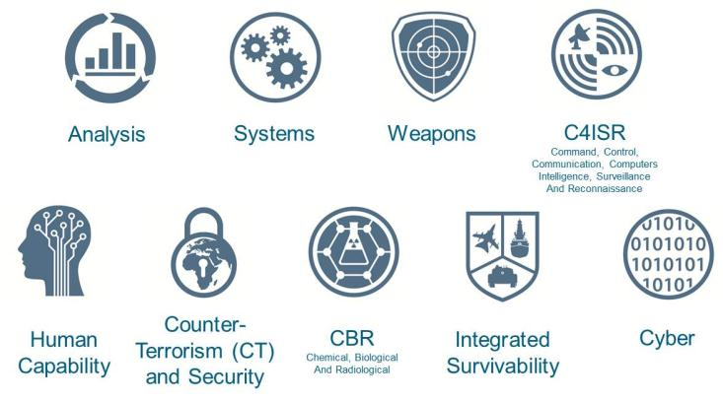
Our 9 priority science and technology capabilities
Notes:
In order for Dstl to address critical S&T problems, our capabilities are aligned to defence and security priorities and provide a balance of delivery for now and for the future. Working with partners and suppliers, we integrate the most appropriate external capabilities into overall delivery.
Based on our customers’ requirements, we have defined nine broad priority capability areas in which we, and our suppliers and partners, deliver benefit to defence and security:
Analysis - Using scientific methods to solve complex policy, planning and operational problems, we help customers to make informed and evidence-based decisions.
2 Chemical, Biological and Radiological (CBR) - We provide authoritative S&T advice to UK Government on CBR materials and counter the threat associated with them.
3 Command, Control, Communication, Computers, Intelligence, Surveillance and Reconnaissance (C4ISR) - We develop approaches to improve the integration of networks, sensors and intelligence.
Counter-Terrorism (CT) and Security - We enable a safer Britain through the delivery of S&T in support of current and future CT and security operations.
Cyber - We develop new cyber capabilities to defend our digital assets and to achieve UK security objectives.
Human Capability - We enable the contribution of the human to be optimised in defence and security capability through the exploitation of S&T.
Integrated Survivability - We use systems-engineering methodology to achieve the best survivability at an affordable cost so that missions can be completed successfully in the face of a hostile environment.
Weapons - We provide S&T advice, assurance and assessment in support of Operational Advantage (superior technology and other forms of battle-winning edge, which increase success in combat and reduce the risk of danger to UK personnel and equipment) and Freedom of Action (effectively operating, maintaining, and refreshing certain capabilities without dependency on others).
Systems - We focus on the application of systems-engineering approaches, primarily to the land, sea and air military platforms, to provide advice and evidence that enables technology integration into the platforms.
To address the rapidly developing S&T domain, our nine priority S&T areas are underpinned by a strong emphasis on S&T futures. Our main focus on S&T futures is led through the Knowledge, Innovation and Futures Enterprise (KnIFE) programme, which is aimed at avoiding technological surprise.
In 2015, MOD’s Chief Scientific Adviser commissioned an independent review of three of our nine key capability areas (Human Capability, Weapons and Integrated Survivability), including the capability held in industry. The reviews gave assurance that the right capabilities were being sustained and developed in the UK to meet future defence and security needs, and that the current capability is fit for purpose.
The findings from these reviews supported a Science Capability Review, chaired by the Government CSA, which looked at the gap between strategy and current defence and security capability in ten different areas.
[Taken from 2014/15 Annual Report and Accounts]

Slide 5

UNCLASSIFIED
Introduction to DTRA’s
Research and Development Directorate
Distribution Statement A . Approved for public release; distribution is unlimited.
UNCLASSIFIED

Slide 6
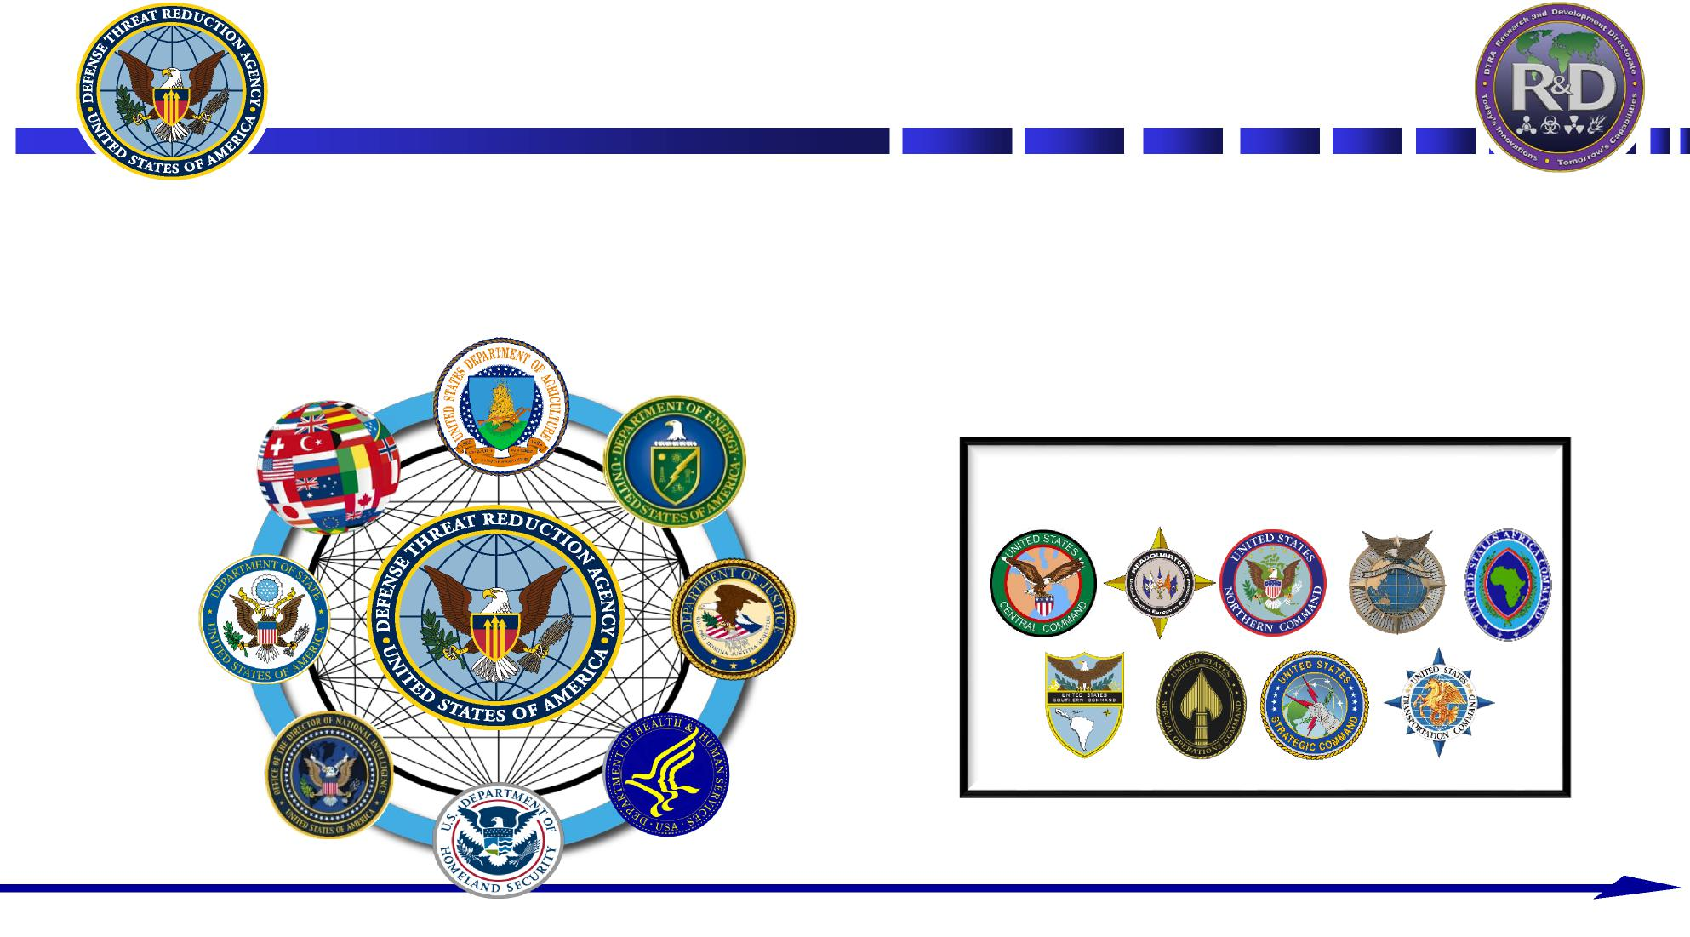
UNCLASSIFIED
Agency Mission
The Defense Threat Reduction Agency enables DoD and the U.S.
Government to prepare for and combat weapons of mass destruction and improvised threats and to ensure nuclear deterrence
Combatant Command Customers
UNCLASSIFIED

Slide 7
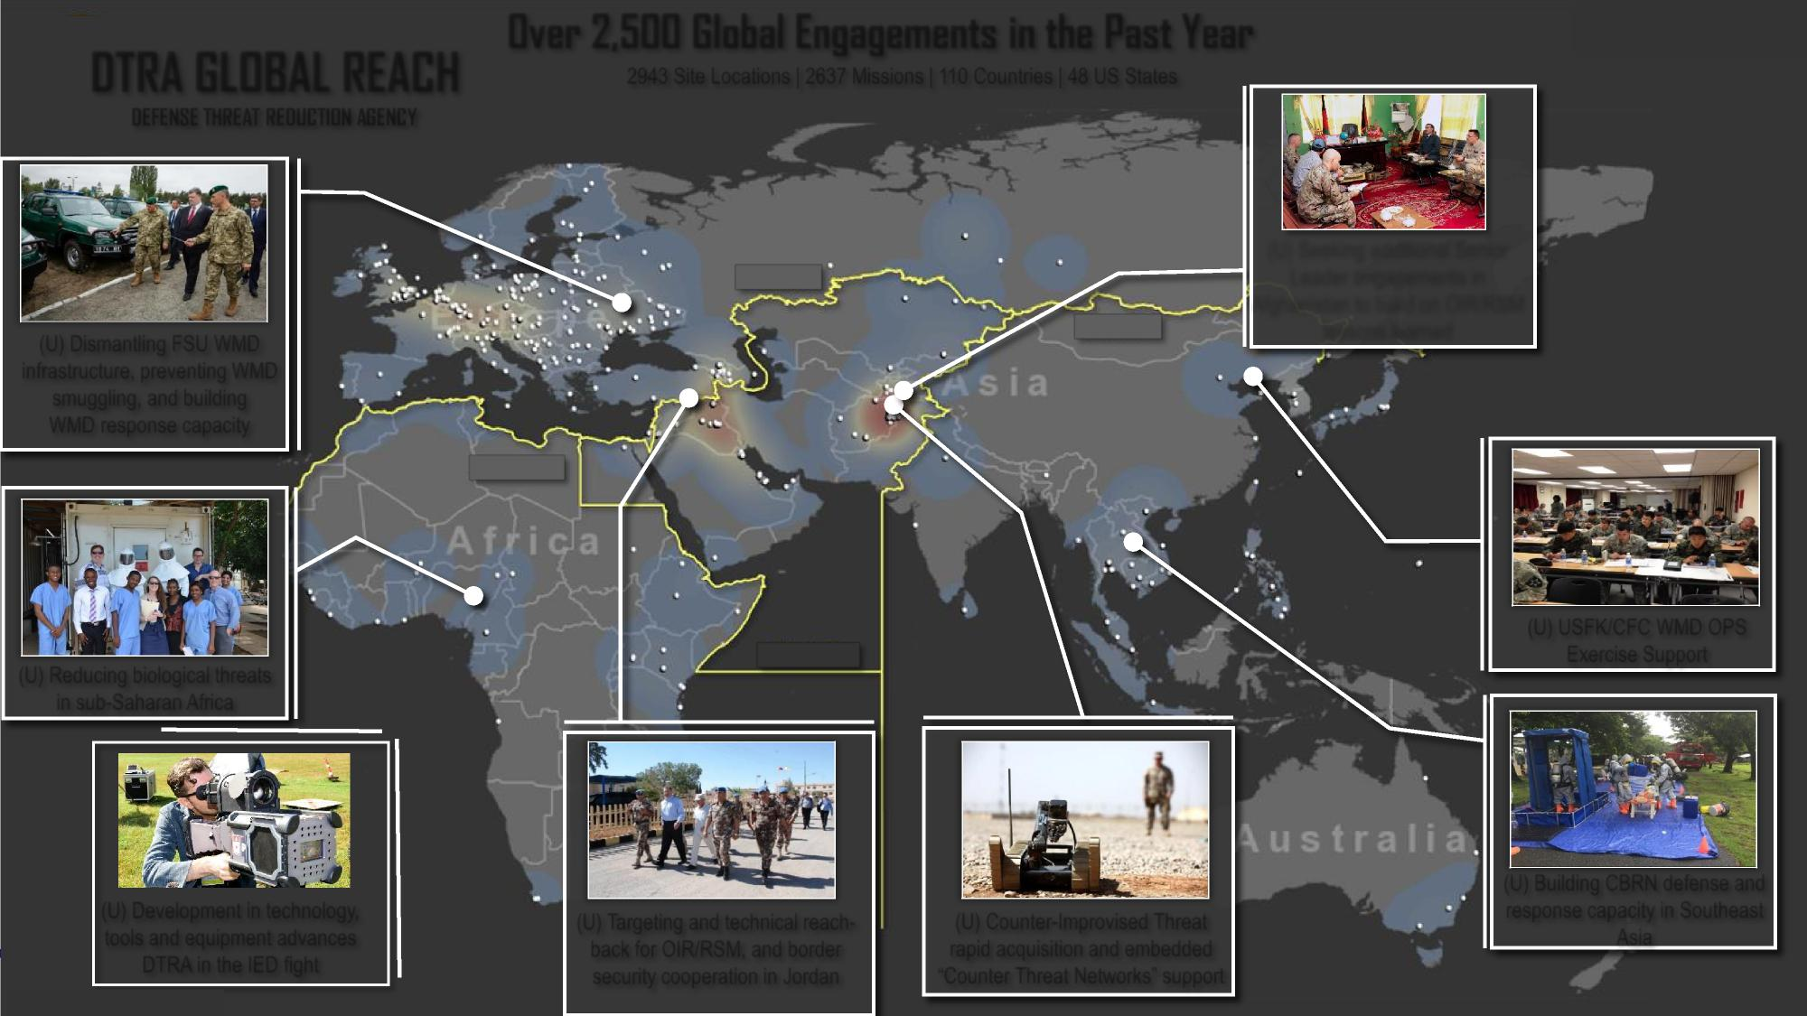
Over 2,500 Global Engagements in the Past Year
UNCLASSIFIED
UNCLASSIFIED
DTRA GLOBAL REACH
2943 Site Locations | 2637 Missions | 110 Countries | 48 US States
DEFENSE THREAT REDUCTION AGENCY
(U) Seeking additional Senior Leader engagements in Afghanistan to build on OIR/RSM lessons learned
USEUCOM
(U) Dismantling FSU WMD infrastructure, preventing WMD smuggling, and building WMD response capacity
USPACOM
USAFIRCOM
(U) USFK/CFC WMD OPS Exercise Support
(U) Reducing biological threats in sub-Saharan Africa
USCENTCOM
5
(U) Development in technology, tools and equipment advances
(U) Building CBRN defense and response capacity in Southeast Asia
(U) Targeting and technical reach- back for OIR/RSM, and border security cooperation in Jordan
(U) Counter-Improvised Threat rapid acquisition and embedded “Counter Threat Networks” support
DTRA in the IED fight
UNCLASSIFIED

Slide 8

UNCLASSIFIED
Biosurveillance Ecosystem (BSVE)
Distribution A: Approved for public release; distribution is unlimited
UNCLASSIFIED

Slide 9

UNCLASSIFIED
BLUF
Providing an innovative platform for advanced analytics
Leveraging and expanding our collaboration with the interagency and international partners
Supporting Combatant Commanders’ requirements
The platform can be an integration and demonstration capability for DTRA technologies
UNCLASSIFIED 2

Slide 10




UNCLASSIFIED
BSVE Accomplishments
Data
86 unique data sources
Analyst verified feeds, Expert domain, Academic domain, Domain news, Non-Domain news, Social Media, Notifiable Disease Data
800,000+ RSS feed articles
> 3 billion tweets
6.5 million public health records
20,000+ reports
11,000+ diagnostic tests
Apps
46 apps live in the BSVE
Software Developers Kit (SDK) allows analysts and developers to incorporate data and analytics
Users
700+ Registered Users
DoD
Interagency: DHS, CDC, HHS, USAID, USGS, VA
UNCLASSIFIED 3

Slide 11
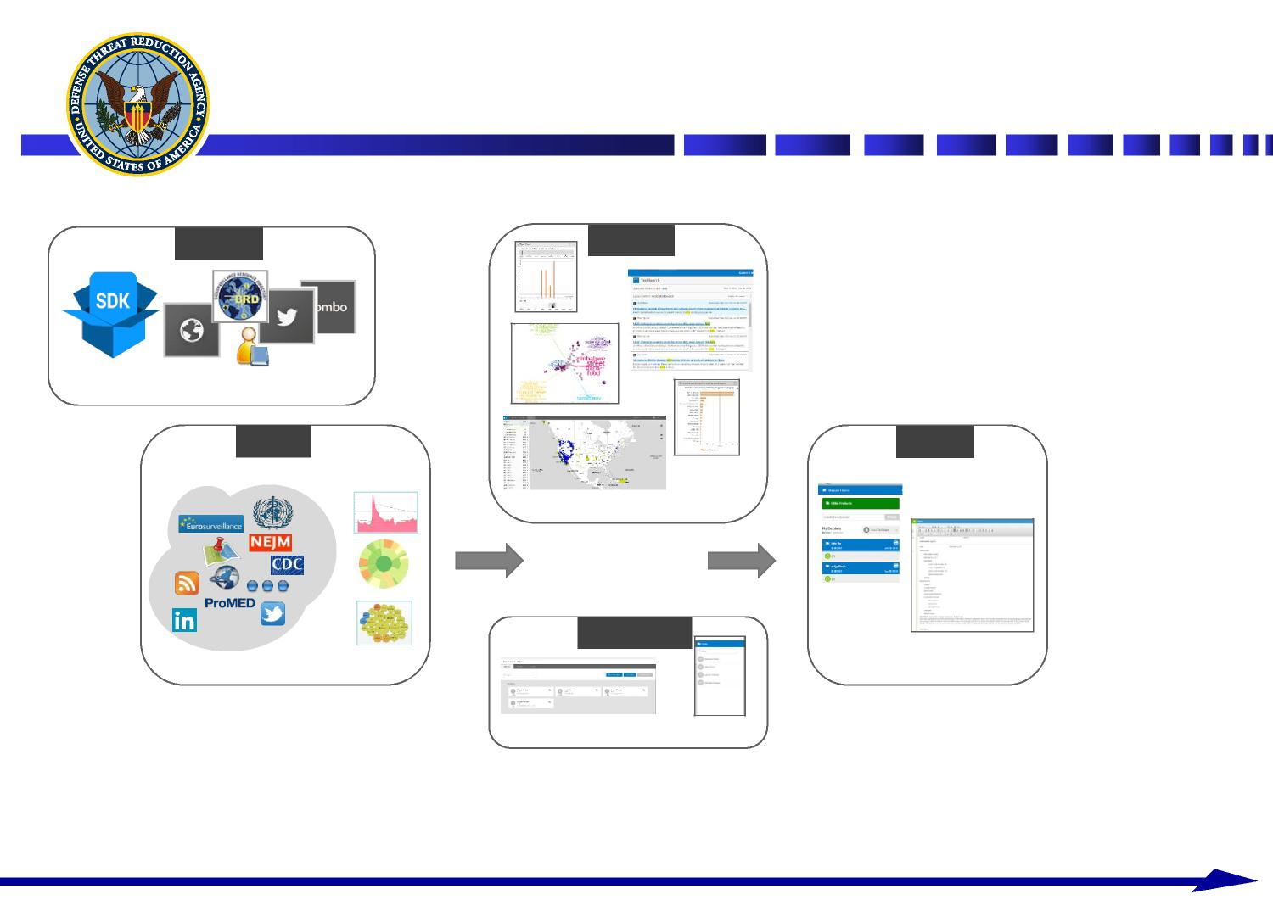
UNCLASSIFIED
Biosurveillance Ecosystem
Develop
Analyze
Ongoing growth and development
Detect
Report
Search, Investigate, Visualize
Prioritized starting points
Products
Collaborate
Automated surveillance for data anomalies
Collect, Organize and Produce
Secure, facilitated, work sharing
A platform for people, data, tools and future needs
UNCLASSIFIED
4

Slide 12
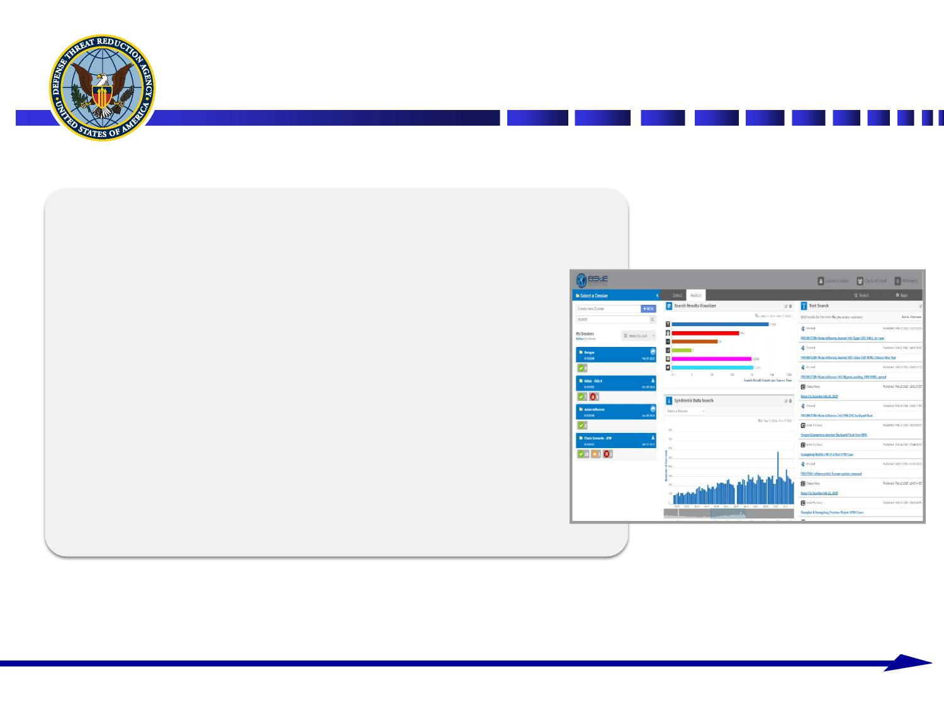
UNCLASSIFIED
Biosurveillance Analyst Needs Addressed
Efficient Use of Time
Improved workflows and reduced reading burden
Secure Collaboration on Work Products
Tracking of Work in Progress in the Dossier
Analytics and Visualizations
Facilitated Reporting
Automated Data Surveillance
UNCLASSIFIED
5

Slide 13
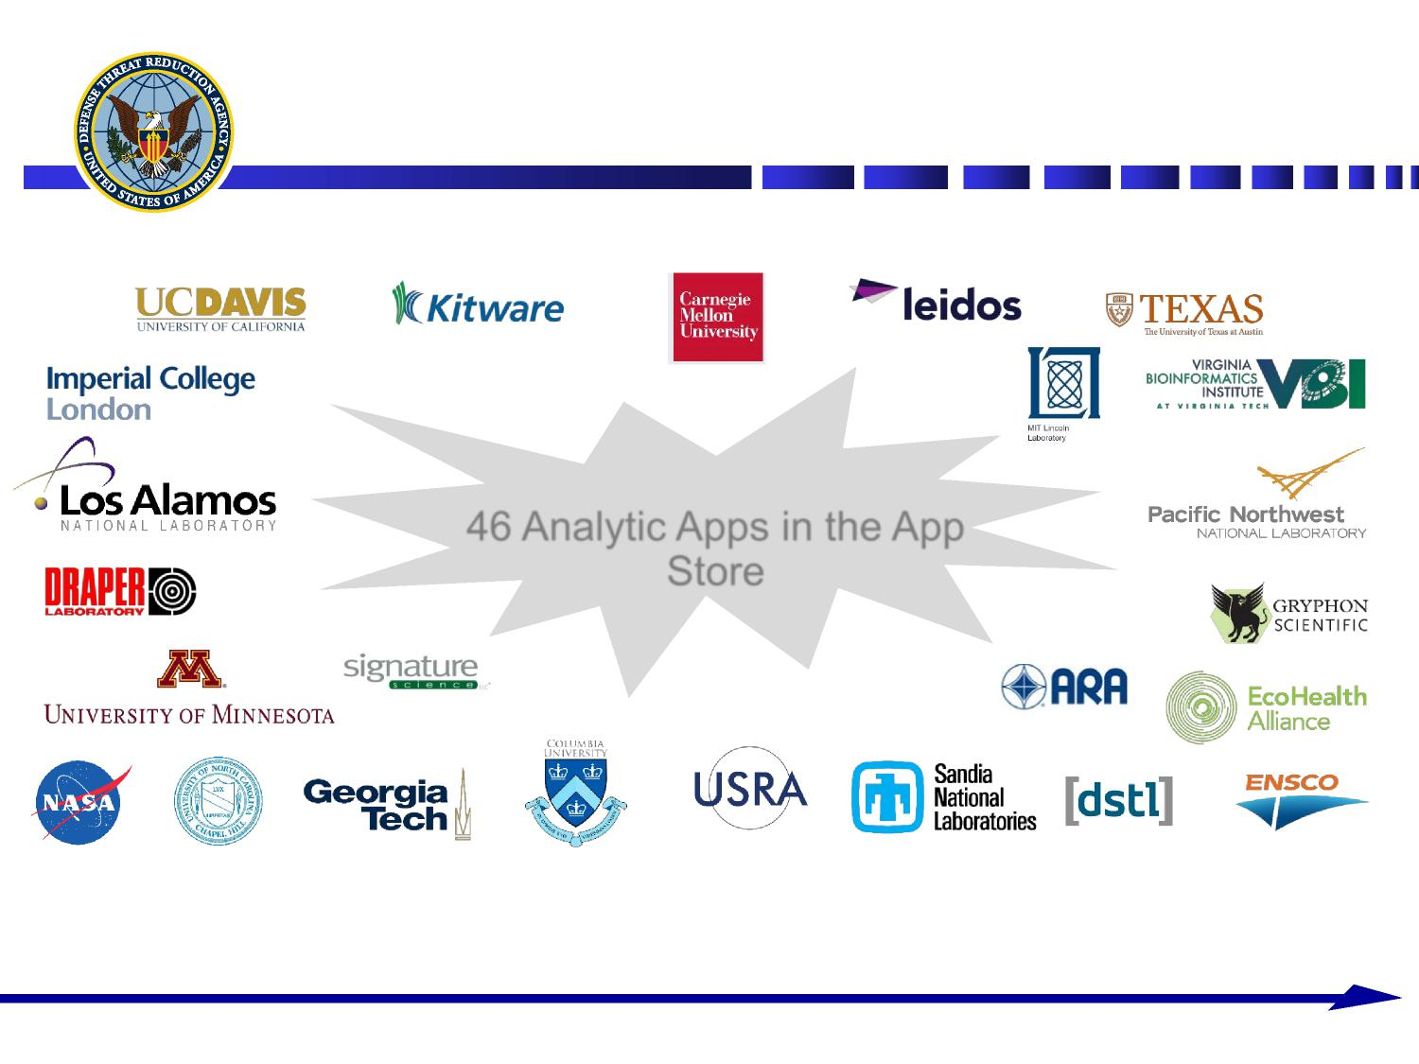
UNCLASSIFIED
Ecosystem Partners/SDK Users
UNCLASSIFIED
9

Slide 14
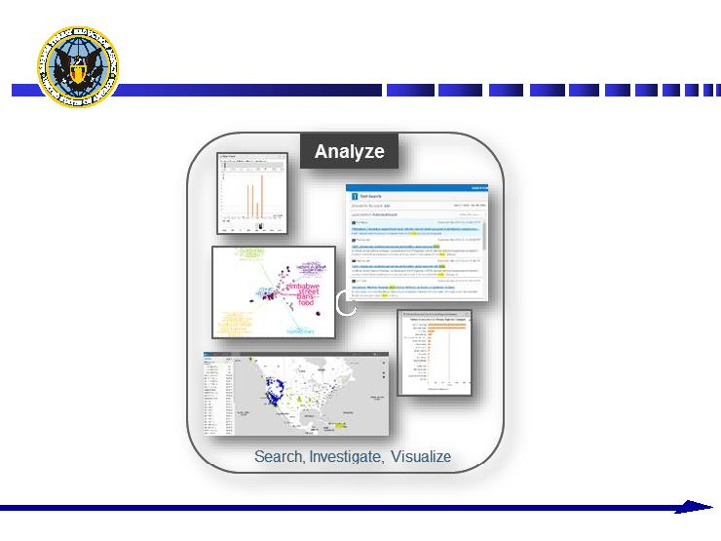
UNCLASSIFIED
Analyze
UNCLASSIFIED
19

Slide 15
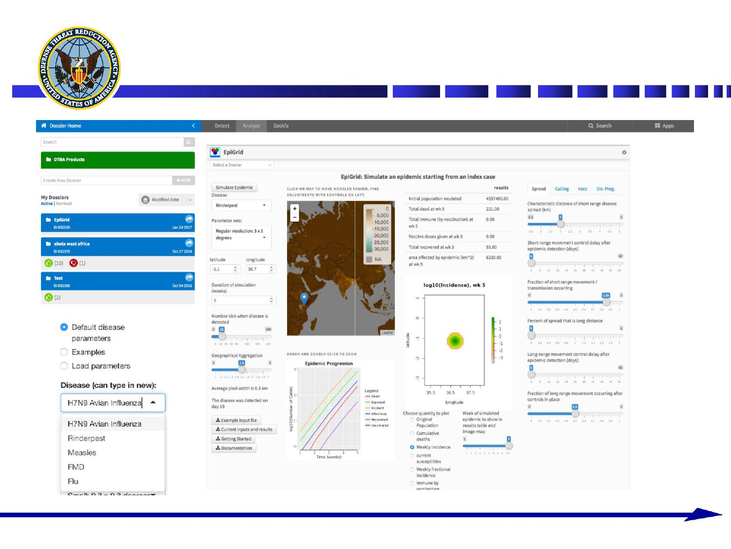
UNCLASSIFIED
EpiGrid – 3rd Party SDK
UNCLASSIFIED
27

Slide 16
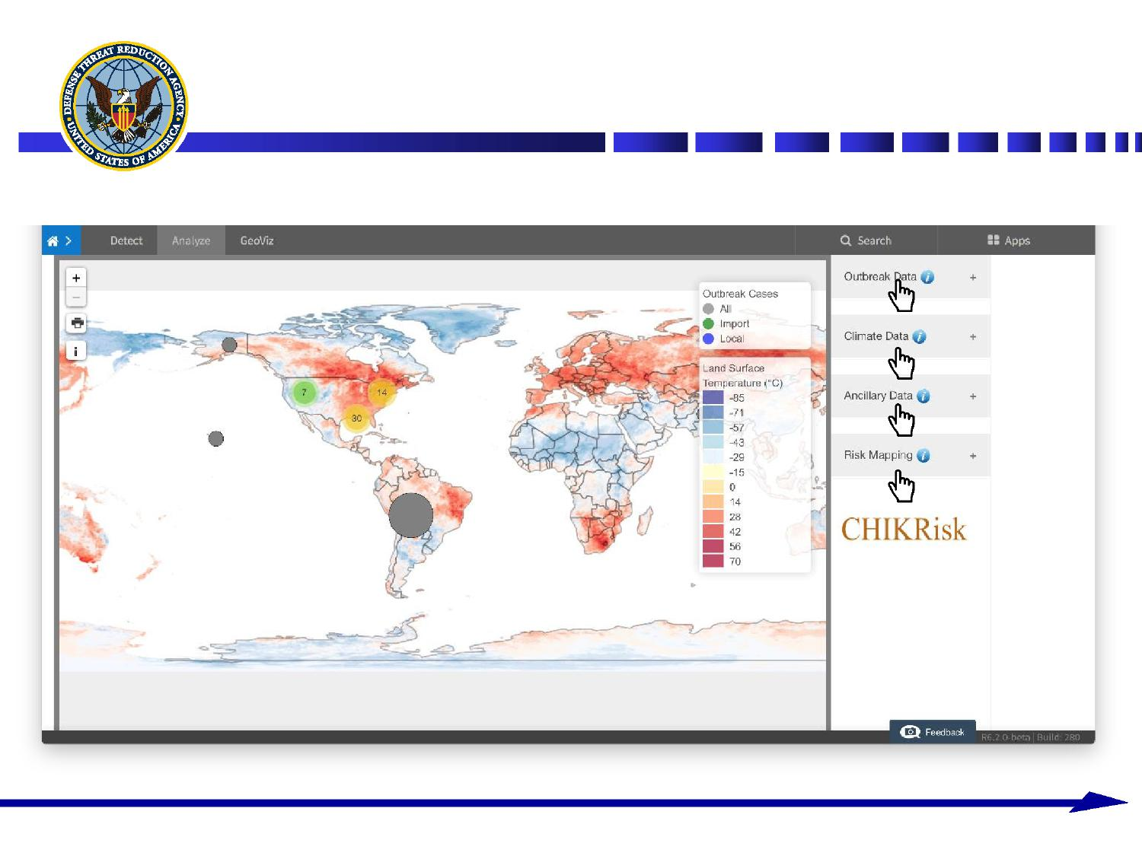
UNCLASSIFIED
CHIKRISK – 3rd Party SDK
UNCLASSIFIED
28

Slide 17
Attendees should be aware that all disclosures during the event will be treated as a public disclosure and all presentation materials will be treated as published material.
Presentation materials and a record of discussions will be made available to all attendees for free, unrestricted use.

Slide 18






Overview

Slide 19

Introduction to Disease Forecasting
Decision makers need to understand the impact of
A harmful release
An outbreak
Impact is usually assessed as total number of cases
Prediction of case numbers is highly complex and intrinsically uncertain
Decision makers need to decide on a course of action
Delay in this decision can cost lives

Slide 20
Aims
Develop an integrated and intuitive system allowing
Disease Forecasting
Uncertainty Quantification
Intervention Exploration and Optimization
Visualization
Decision Support
Scenario Planning

Slide 21
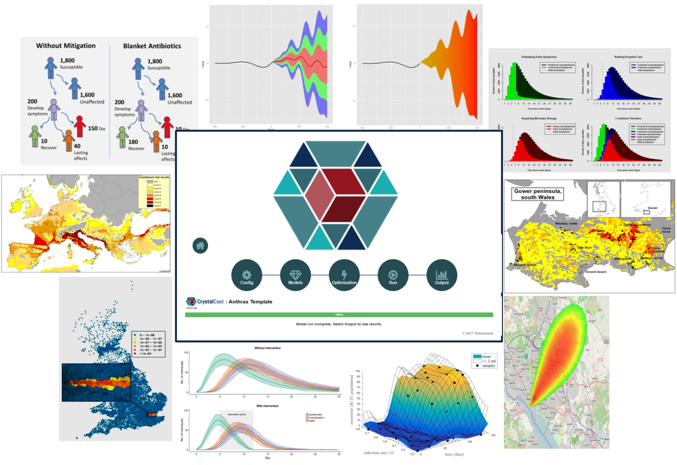
Vision

Slide 22
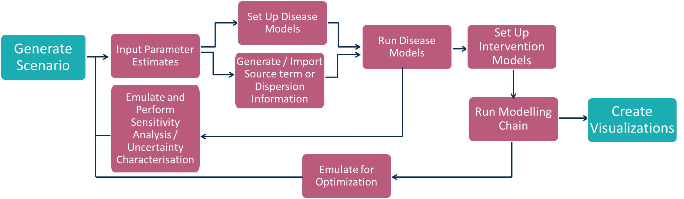
System Structure

Slide 23


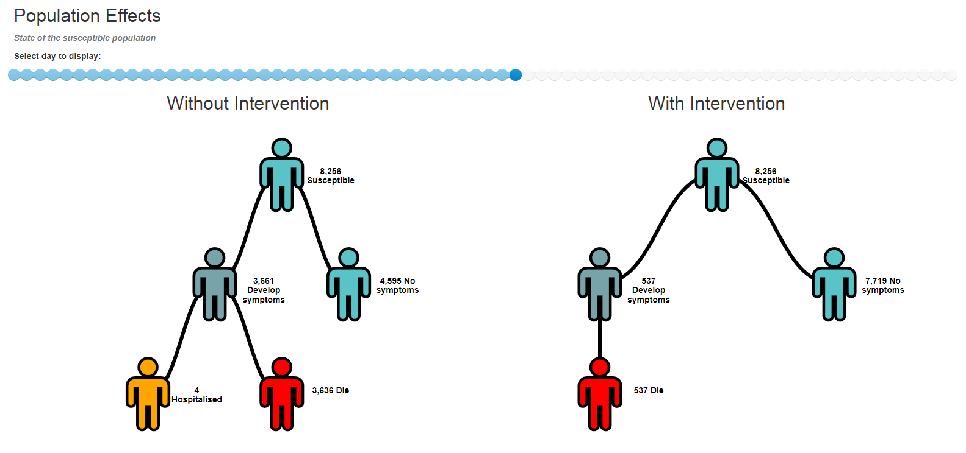
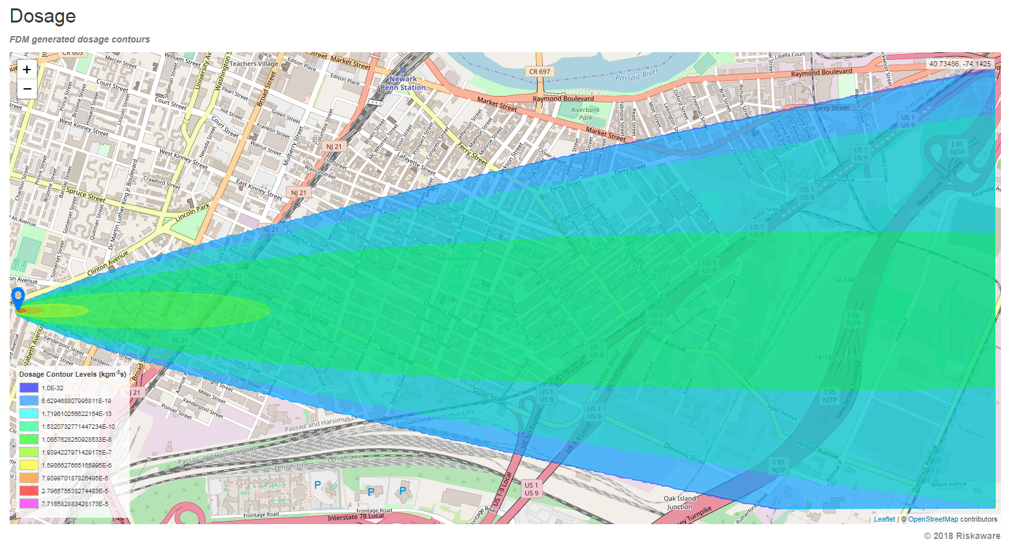
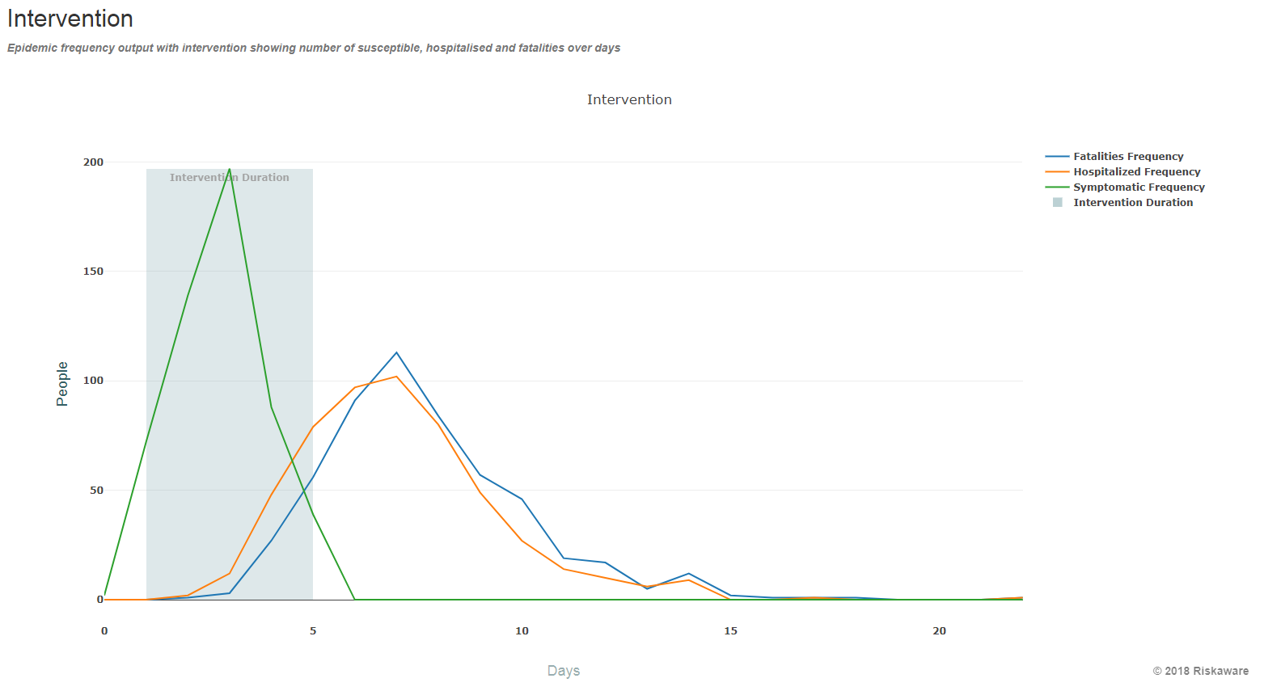
Prototype Visualisation Methodology
An easy to use system interface has been developed
Initial visualizations have been implemented into the system

Slide 24
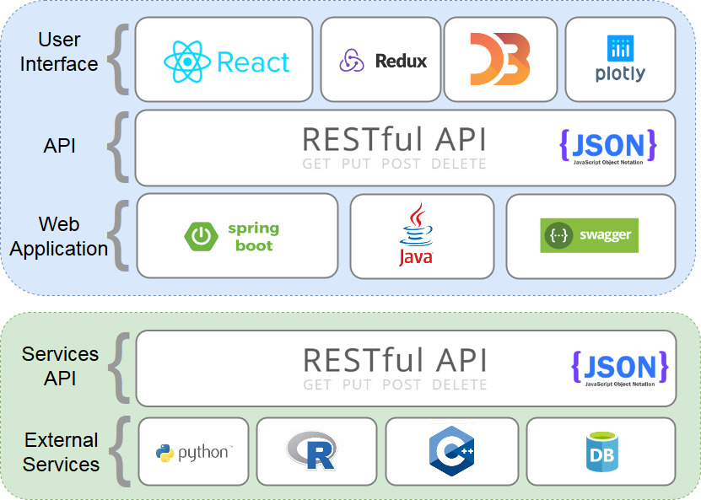
Integration and System Framework Demonstrator

Slide 25
Workshop Objective
Explore and create innovative ways to visualise the complex output from the CrystalCast system in order to provide a decision maker with the understanding required to make a reasoned decision

Slide 26
Working Groups
Visualization of Underpinning Model Assumptions
Decision Aids that include Data Summaries and Temporal Predictions
Spatio-temporal Uncertainty Visualization
Visualizing Uncertainty in the Numbers in ‘at Risk’ Groups Due to Multiple Model Predictions

Slide 27
Outputs
Each working group should capture their ideas, visualisations and if appropriate developed code
The specifics of this will be covered in Matt’s presentation later

Slide 28
Notes:
This slide may be shown at the end of the presentation.

